Slide 1
Lazy Learning

Slide 2
Understanding nearest neighbor classification
Nearest neighbor classifiers are defined by their characteristic of classifying unlabeled examples by assigning them the class of similar labeled examples.
Despite the simplicity of this idea, nearest neighbor methods are extremely powerful. They have been used successfully for:
.Computer vision applications, including optical character recognition and facial recognition in both still images and video
• Predicting whether a person will enjoy a movie or music recommendation • Identifying patterns in genetic data, perhaps to use them in detecting specific proteins or diseases

Slide 3
In general, nearest neighbor classifiers are well-suited for classification tasks, where relationships among the features and the target classes are numerous, complicated, or extremely difficult to understand, yet the items of similar class type tend to be fairly homogeneous
The k-NN algorithm
The nearest neighbors approach to classification is exemplified by the k-nearest neighbors algorithm (k-NN). one of the simplest machine learning algorithms, it is still used widely

Slide 4
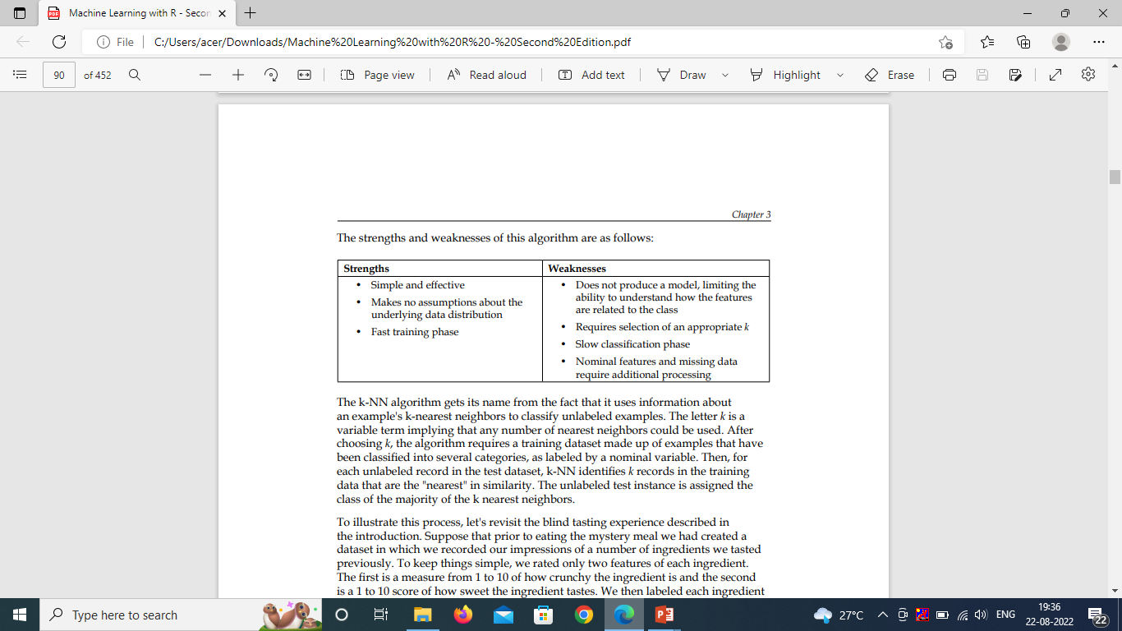
The k-NN algorithm gets its name from the fact that it uses information about an example's k-nearest neighbors to classify unlabeled examples. . The letter k is a variable term implying that any number of nearest neighbors could be used

Slide 5
After choosing k, the algorithm requires a training dataset made up of examples that have been classified into several categories, as labeled by a nominal variable.
Then, for each unlabeled record in the test dataset, k-NN identifies k records in the training data that are the "nearest" in similarity. The unlabeled test instance is assigned the class of the majority of the k nearest neighbors
Suppose that prior to eating the mystery meal we had created a dataset in which we recorded our impressions of a number of ingredients we tasted previously. To keep things simple, we rated only two features of each ingredient. The first is a measure from 1 to 10 of how crunchy the ingredient is and the second is a 1 to 10 score of how sweet the ingredient tastes. We then labeled each ingredient as one of the three types of food: fruits, vegetables, or proteins.

Slide 6
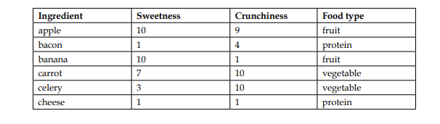
The k-NN algorithm treats the features as coordinates in a multidimensional feature space. As our dataset includes only two features, the feature space is two-dimensional. We can plot two-dimensional data on a scatter plot, with the x dimension indicating the ingredient's sweetness and the y dimension, the crunchiness

Slide 7
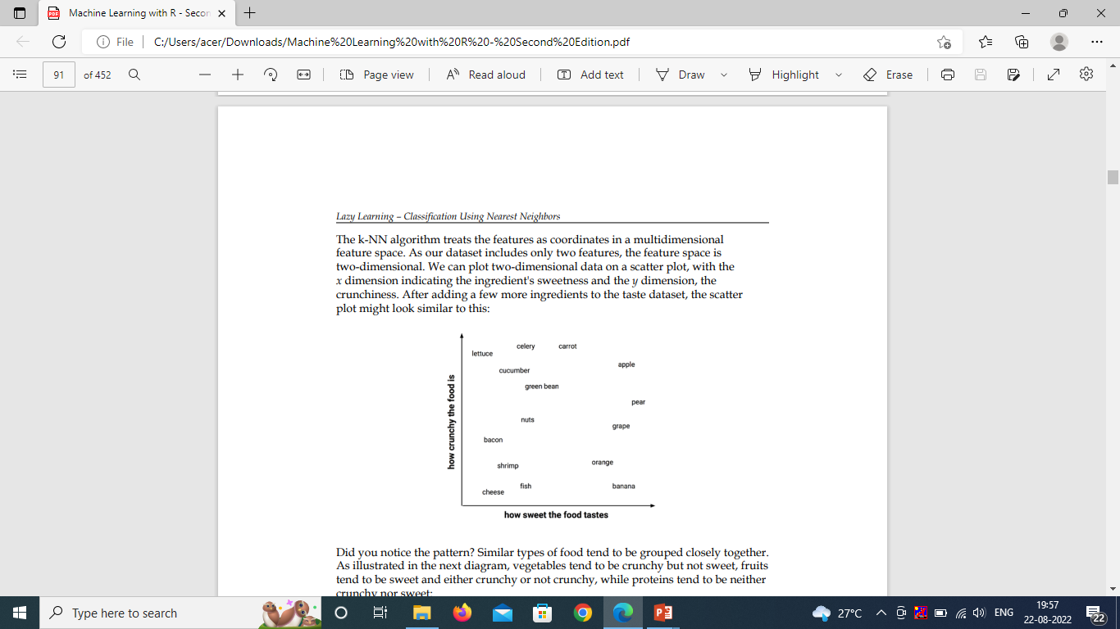
After adding a few more ingredients

Slide 8
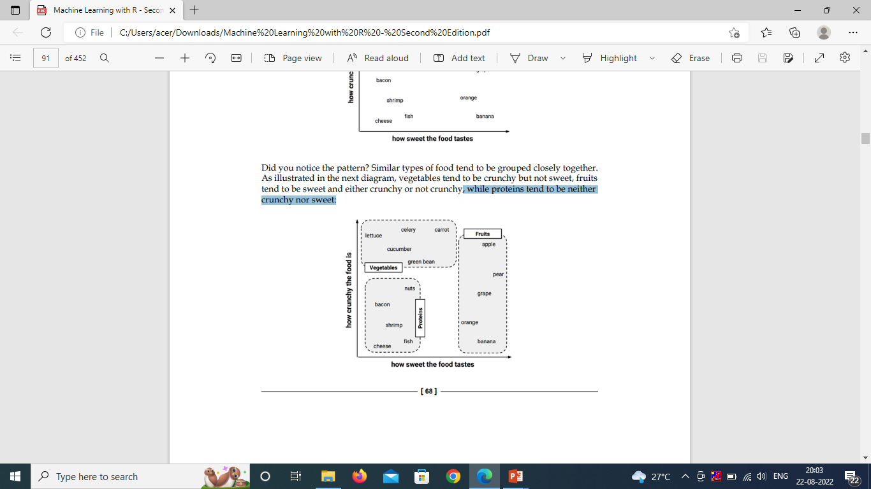
Similar types of food tend to be grouped closely together.
Here, vegetables tend to be crunchy but not sweet, fruits tend to be sweet and either crunchy or not crunchy,
-, while proteins tend to be neither crunchy nor sweet:

Slide 9
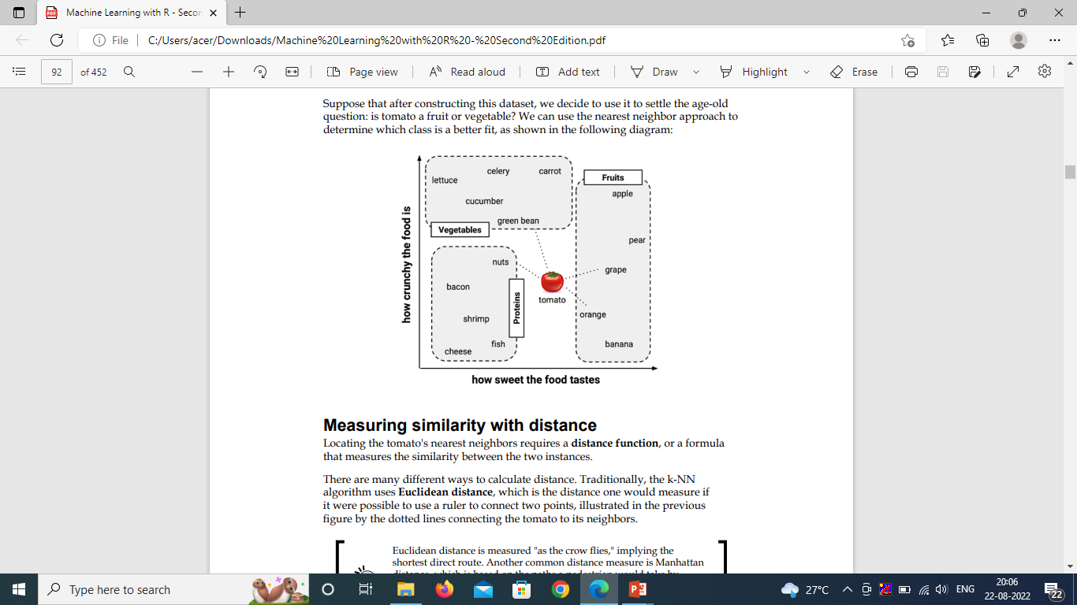
Measuring similarity with distance

Slide 10
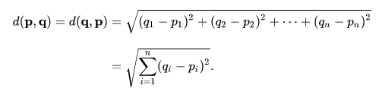
Locating the tomato's nearest neighbors requires a distance function, or a formula that measures the similarity between the two instances
Euclidean distance, which is the distance one would measure if it were possible to use a ruler to connect two points, illustrated in the previous figure by the dotted lines connecting the tomato to its neighbors
Euclidean distance is calculated as the square root of the sum of the squared differences between the two vectors.
where p and q are the examples to be compared, each having n features. p1 refers to the value of the first feature of example p, while q1 refers to the value of the first feature of example q

Slide 11
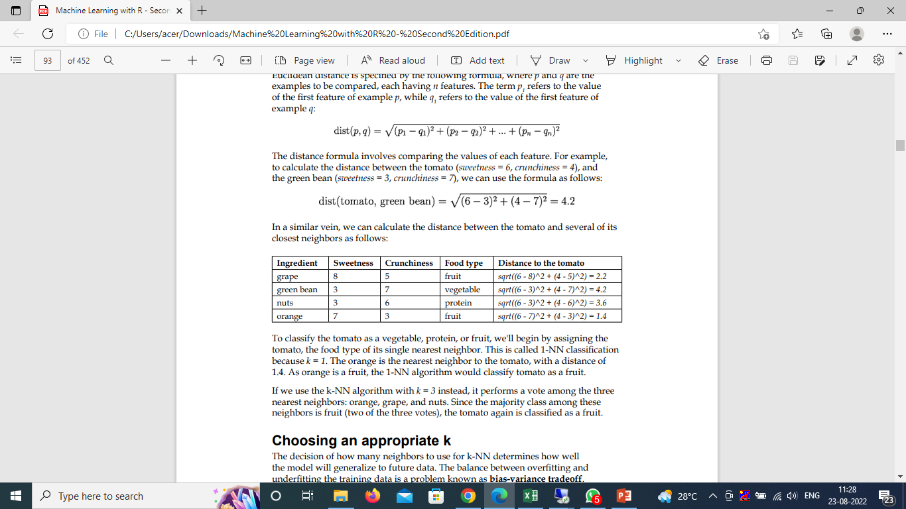

The distance formula involves comparing the values of each feature. For example, to calculate the distance between the tomato (sweetness = 6, crunchiness = 4), and the green bean (sweetness = 3, crunchiness = 7), we can use the formula as follows
similarly , we can calculate the distance between the tomato and several of its closest neighbors as follows:
This is called 1-NN classification because k = 1. The orange is the nearest neighbor to the tomato, with a distance of 1.4. As orange is a fruit, the 1-NN algorithm would classify tomato as a fruit

Slide 12
Choosing an appropriate k
The decision of how many neighbors to use for k-NN determines how well the model will generalize to future data. The balance between overfitting and underfitting the training data is a problem known as bias-variance tradeoff. Choosing a large k reduces the impact or variance caused by noisy data, but can bias the learner so that it runs the risk of ignoring small, but important patterns
The following figure illustrates, more generally, how the decision boundary (depicted by a dashed line) is affected by larger or smaller k values. Smaller values allow more complex decision boundaries that more carefully fit the training data. The problem is that we do not know whether the straight boundary or the curved boundary better represents the true underlying concept to be learned

Slide 13
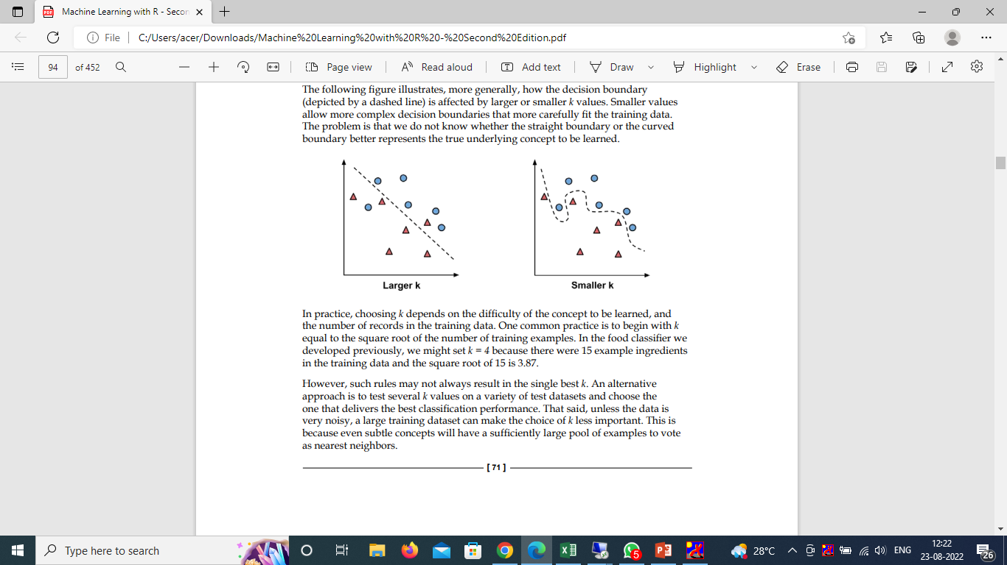
Decision boundary
choosing k depends on the difficulty of the concept to be learned, and the number of records in the training data. One common practice is to begin with k equal to the square root of the number of training examples. . In the food classifier we developed previously, we might set k = 4 because there were 15 example ingredients in the training data and the square root of 15 is 3.87
. An alternative approach is to test several k values on a variety of test datasets and choose the one that delivers the best classification performance. That said, unless the data is very noisy, a large training dataset can make the choice of k less important. This is because even subtle concepts will have a sufficiently large pool of examples to vote as nearest neighbors.

Slide 14
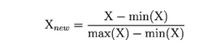
Preparing data for use with k-NN
The traditional method of rescaling features for k-NN is min-max normalization. This process transforms a feature such that all of its values fall in a range between 0 and 1. The formula for normalizing a feature is
Essentially, the formula subtracts the minimum of feature X from each value and divides by the range of X.
Normalized feature values can be interpreted as indicating how far, from 0 percent to 100 percent, the original value fell along the range between the original minimum and maximum.

Slide 15
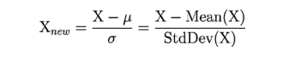
Another common transformation is called z-score standardization.
The following formula subtracts the mean value of feature X, and divides the outcome by the standard deviation of X
This formula, which is based on the properties of the normal distribution.
--rescales each of the feature's values in terms of how many standard deviations they fall above or below the mean value. The resulting value is called a z-score.
. The z-scores fall in an unbound range of negative and positive numbers. Unlike the normalized values, they have no predefined minimum and maximum

Slide 16
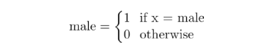
The Euclidean distance formula is not defined for nominal data. Therefore, to calculate the distance between nominal features, we need to convert them into a numeric format.
A typical solution utilizes dummy coding, where a value of 1 indicates one category, and 0, the other.
For instance, dummy coding for a gender variable could be constructed as
Notice how the dummy coding of the two-category (binary) gender variable results in a single new feature named male. There is no need to construct a separate feature for female; since the two sexes are mutually exclusive, knowing one or the other is enough.
An n-category nominal feature can be dummy coded by creating the binary indicator variables for (n - 1) levels of the feature.

Slide 17
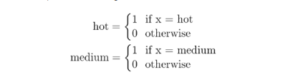
For example, the dummy coding for a three-category temperature variable (for example, hot, medium, or cold) could be set up as (3 - 1) = 2 features, as shown here
Knowing that hot and medium are both 0 is enough to know that the temperature is cold. We, therefore, do not need a third feature for the cold category.
Why is the k-NN algorithm lazy?
A lazy learner is not really learning anything. Instead, it merely stores the training data verbatim. This allows the training phase, which is not actually training anything, to occur very rapidly. The downside is that the process of making predictions tends to be relatively slow in comparison to training.

Slide 18
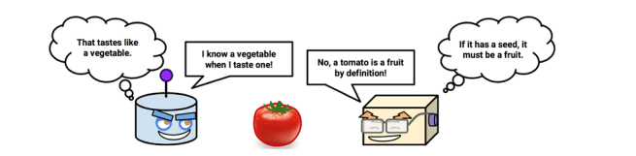
. Due to the heavy reliance on the training instances rather than an abstracted model, lazy learning is also known as instance-based learning or rote learning.
As instance-based learners do not build a model, the method is said to be in a class of non-parametric learning methods—no parameters are learned about the data.
non-parametric methods limit our ability to understand how the classifier is using the data. On the other hand, this allows the learner to find natural patterns rather than trying to fit the data into a preconceived and potentially biased functional form

Slide 19
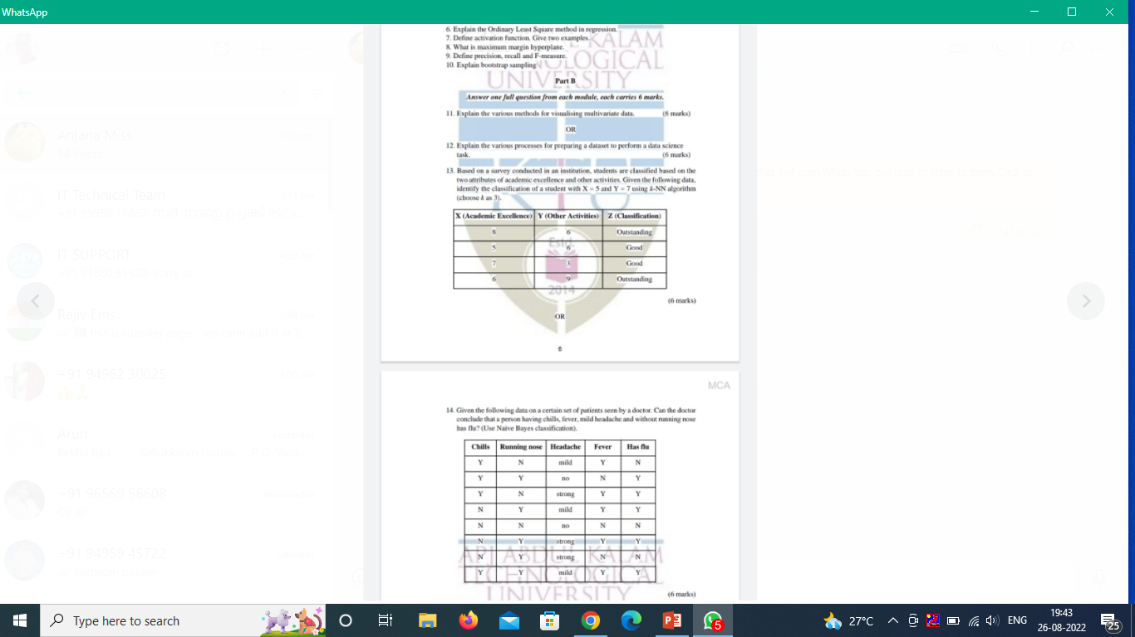

Slide 20
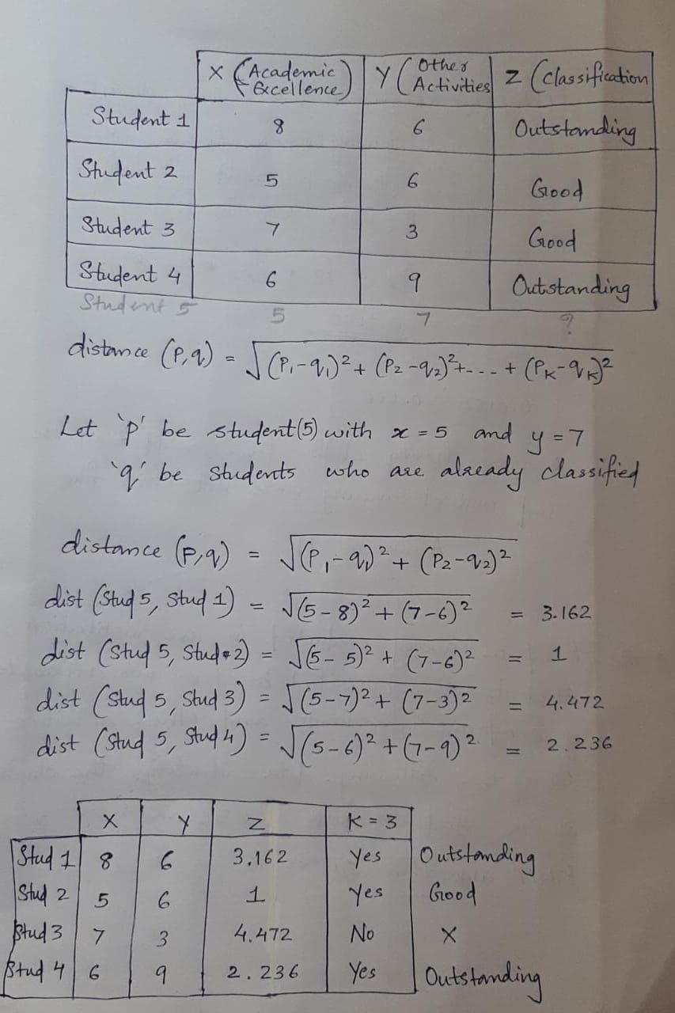

Slide 21
Perform KNN -classification algoritham on following dataset and predict the class for X(P1=3 and P2=7) K=3
P1 | P2 | Class
7 | 7 | False
7 | 4 | False
3 | 4 | True
1 | 4 | True

Slide 22


